Slide 1
ENGI 301 Load Cell Project
9/26/23
Dan Zislis

Slide 2
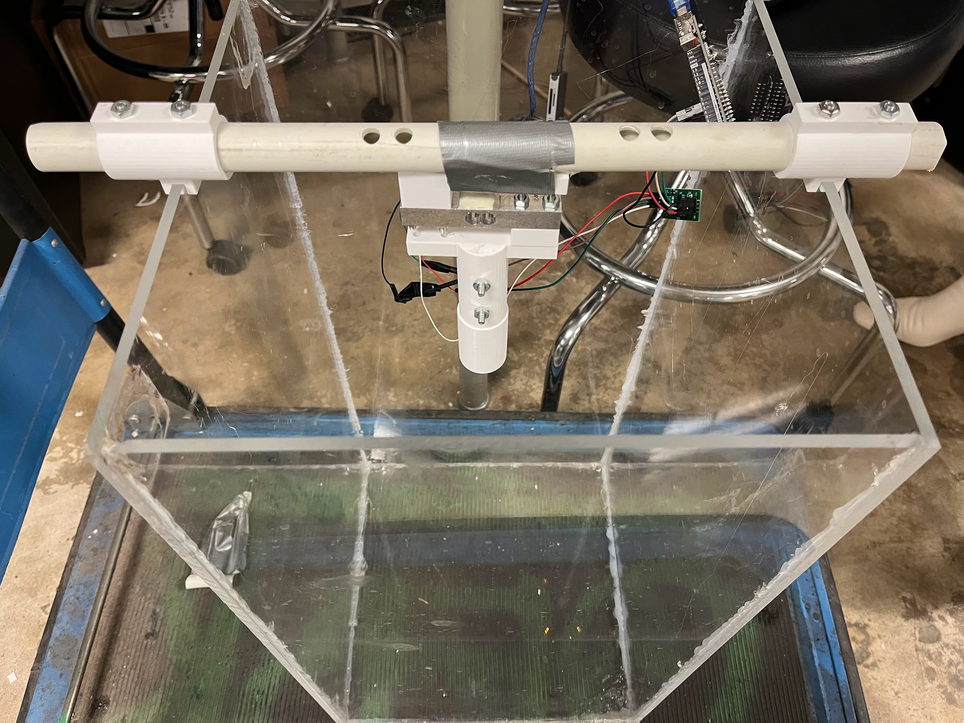
Background Information
Current load cell packages exist, but the hardware is limited by complexity of use
More specicifially, the HX711 is a great package for hobbiests, but mainly developed for Arduino operation through Serial Monitor
For my senior design project, I need to characterize a load cell by creating a curve
The goal of the project is to create a load cell setup that calibrates the load cell, reads values, and saves them to a file.
What improvements / additions over existing project?
Make HX711 compatible with BeagleBone Black
Create a way to generate a .csv file for thruster characteristics
Shown above is the load cell configuration for our testing hardware. The ADC used to convert load cell readings is accessible by a microcontroller (currently an Arduino Uno).

Slide 3
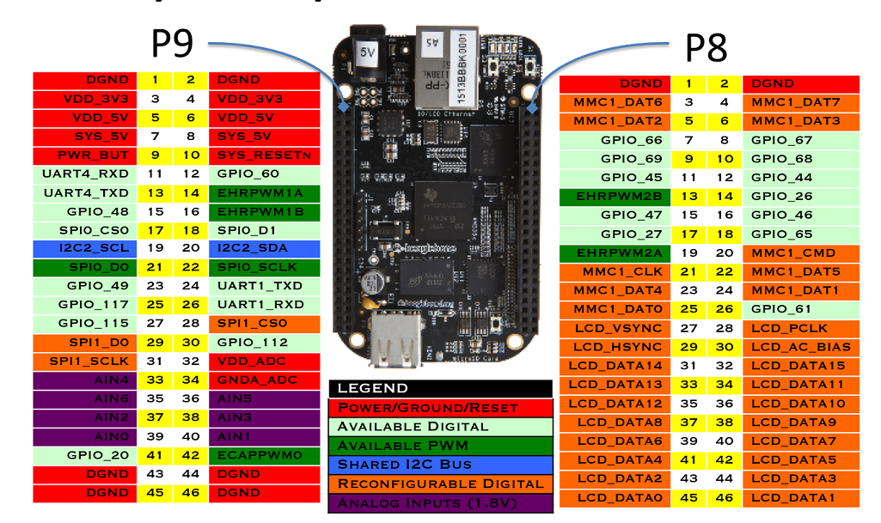
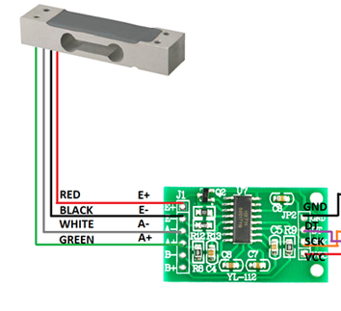
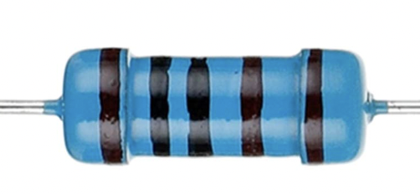
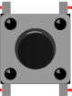
Power Block Diagram
button for starting data log
button for finishing data log

Slide 4
System Block Diagram
Calibration
Tare the calibration cell
While File Saving button hasn’t been pressed
Turn on (Power Through Computer)
Place known weight on scale
Press the data logging button
Obtain reading from Load Cell
Press file saving button to terminate loop
Power off
Tell Beaglebone nominal weight to calibrate
Save as a data point
Load Cell saves calibration factor

Slide 5
Components / Budget
Component | Need to Buy | Link | Cost
HX711 Load Cell Components (ADC, load cell) | 1 | https://www.amazon.com/Geekstory-Weight-Electronic-Kitchen-Weighing/dp/B079FQNJJH | $10
Push Buttons | 2 |  | Given from Class
Wifi Sensor (NRF24L01) (if time permitting) | 2 | https://www.amazon.com/gp/product/B0829ZQ97G | ~$12
Battery (12 V) |  | https://www.amazon.com/Beidongli-Alkaline-Batteries-Endurance-Warranty%E3%80%91/dp/B0BVBC815F/ref=sr_1_20?keywords=12v+battery+pack&qid=1695776859&sr=8-20 | $6 (or can get from OEDK)
Total Budget |  |  | ~$28

